Slide 1
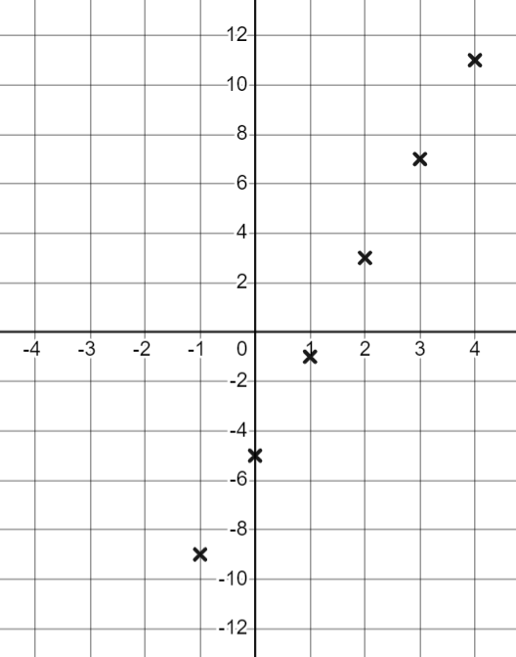
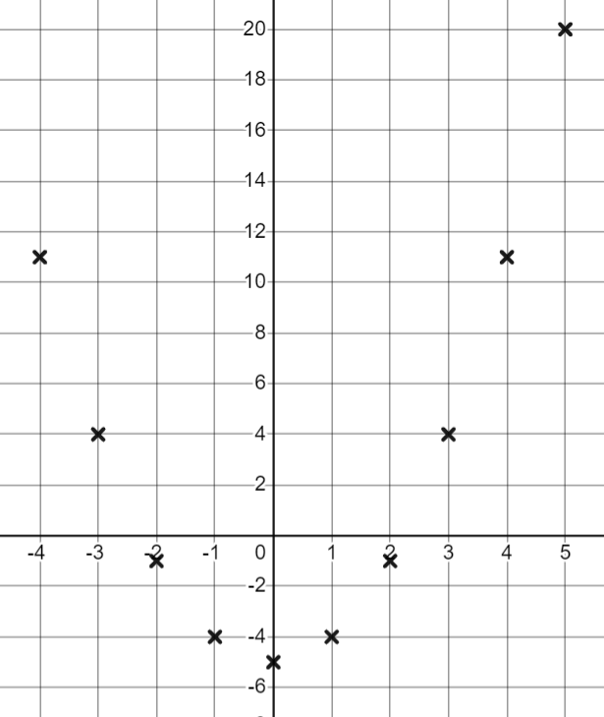
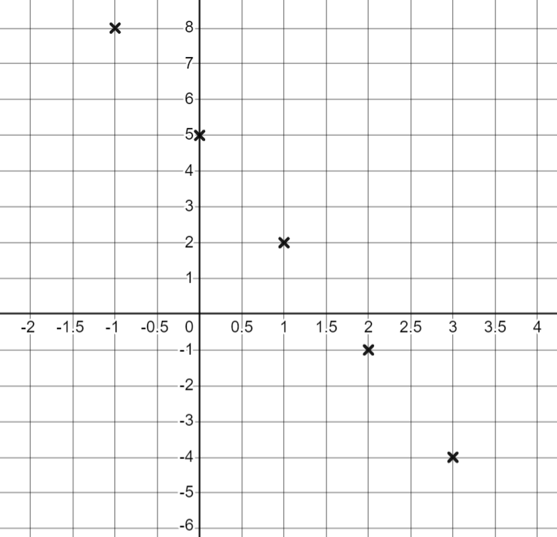


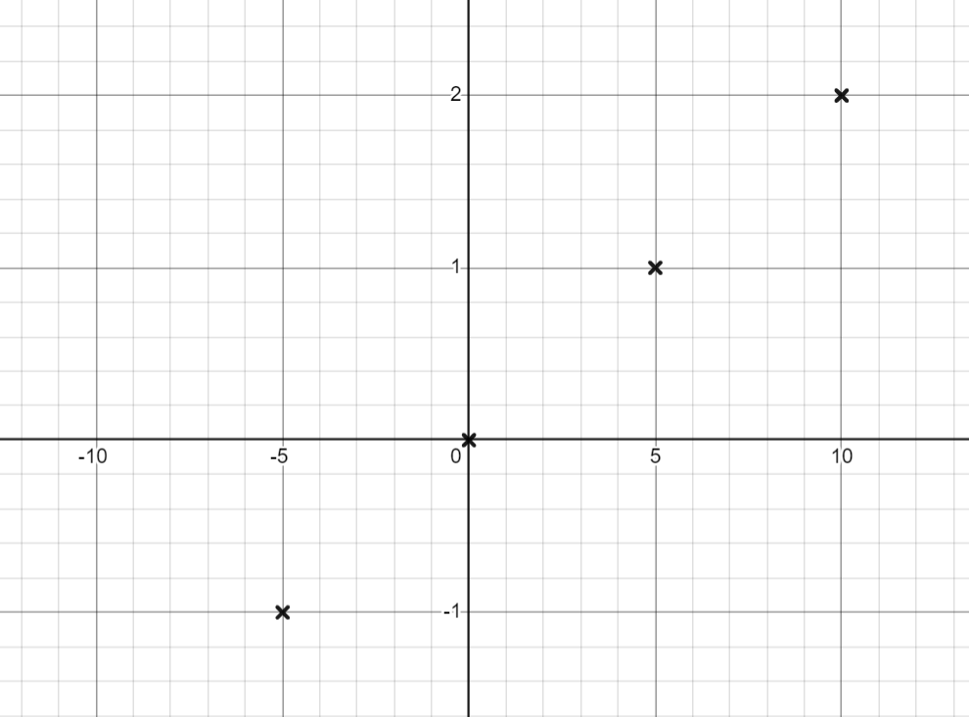
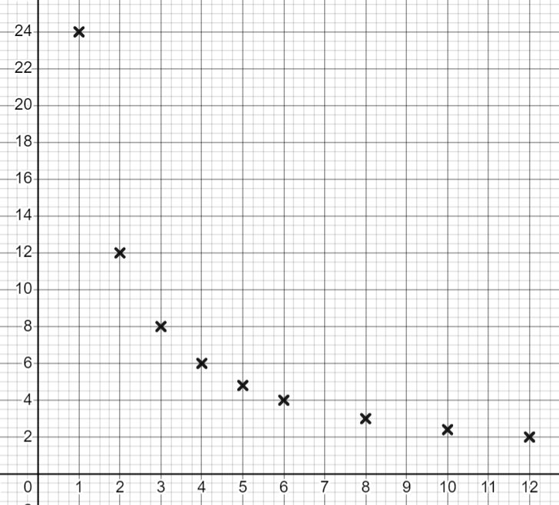
Different types of equations
Task A: Reviewing plotting graphs
1) Fill in the table of values, plot the points for the graphs of each expression.
a) 4a − 5 | b) a² − 5 | c) 5 − 3a
a | −1 | 0 | 1 | 2 | 3 | 4
4a − 5 | −9 | −5 | −1 | 3 | 7 | 11
a | −2 | −1 | 0 | 1 | 2 | 3 | 4
a² − 5 | −1 | −4 | −5 | −4 | −1 | 4 | 11
a | −1 | 0 | 1 | 2 | 3 | 4
5 − 3a | 8 | 5 | 2 | −1 | −4 | −7
d) | e)
b | −10 | −5 | 0 | 5 | 10
 | −2 | −1 | 0 | 1 | 2
x | 1 | 2 | 3 | 4 | 5 | 6 | ..8 | ..10 | ..12
 | 24 | 12 | 8 | 6 | 4.8 | 4 | 3 | 2.4 | 2

Slide 2
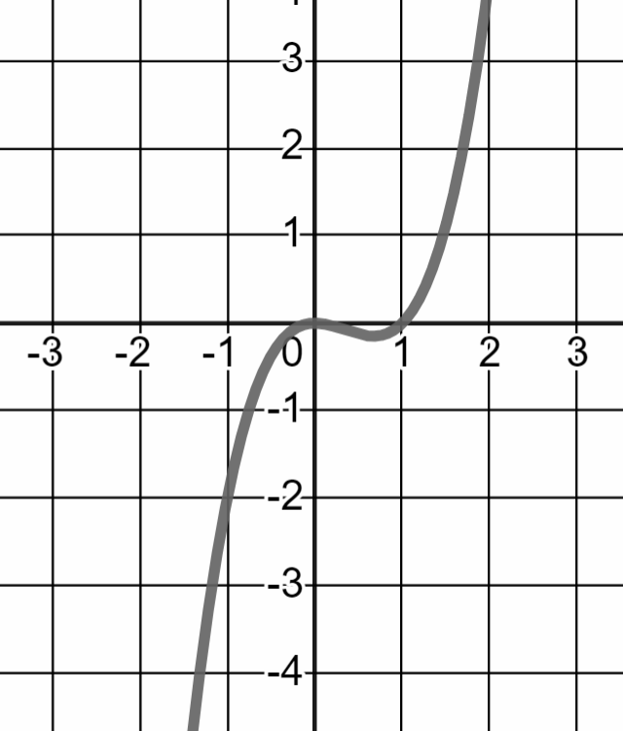

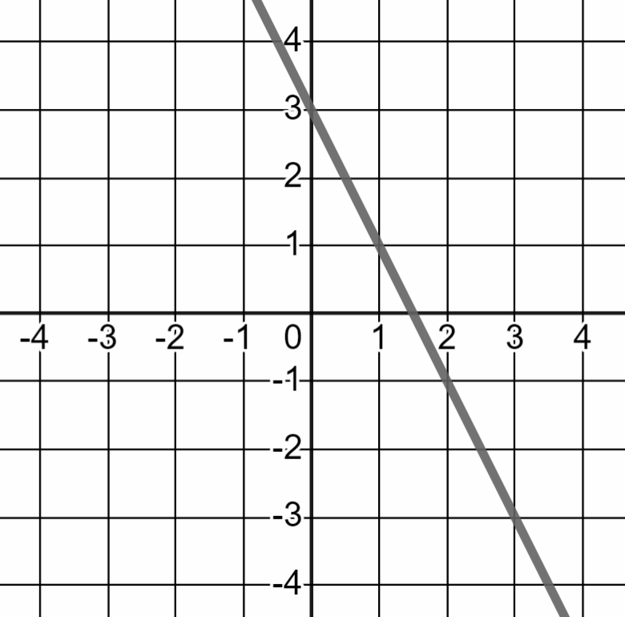

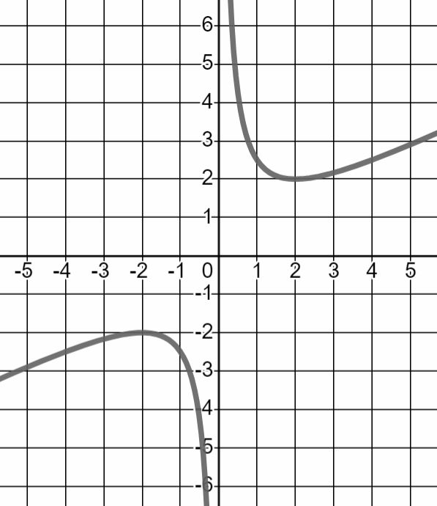
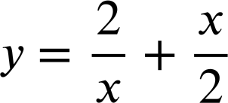
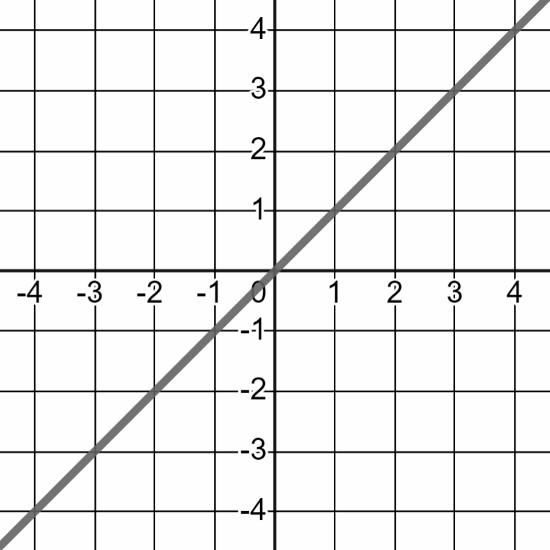
Different types of equations
Task B: Identifying linear equations from graphs
1) Fill in the missing values in the tables. Using these, match the equations to the graphs and state whether each equation is linear or not.
A
F
x | −2 | −1 | 1 | 2
y | −12 | −2 | 0 | 4
Non-linear
B
G
x | −2 | −1 | 1 | 2
y | 7 | 5 | 1 | −1
Linear
C
H
x | −2 | −1 | 1 | 2
y | −2 | −2.5 | 2.5 | 2
Non-linear
E
D
x | −2 | −1 | 1 | 2
y | −2 | −1 | 1 | 2
Linear
Mathematics in Education and Industry
v2.3

